Slide 1
Block 2 Project- Memory game

Slide 2
The idea
The idea for our game was to challenge the user by taking them through a brain teasing exercise that will help challenge the users memory.
We have decided to go with the card memory game because it is quite a popular game in the genre and will help improve a users memory the longer they progress through it.

Slide 3
Design Thinking
We have gone with a simple design that will not confuse the user but help him get started straight away without anything to hold them up.
We have reduced the amount of interaction the user had to go through before getting started with the game and made it much simpler to have the user engaged straight away.
We have come up with this design with the help of our users who have given us feedback on the games user interface and overall playthrough. We have taken this feedback to hearth and have adjusted some areas of the game based on their feedback.

Slide 4
Time management
As a team we have managed our time in different ways for example we had regular meetings where we would discuss the game code and the users feedback on what we can adjust for the game.
We gave ourselves deadlines for different parts of the project to ensure that we are making progress at a constant pace and to ensure we focus on tasks in which we may lack behind for example coding certain functions.

Slide 5
Working as a group
We ensured that our group work is very transparent to all the members in the group by ensuring that we held regular meetings to ensure everyone is making progress on their tasks and no work is overlapping.
Communication is one of the key parts in a group projects, to ensure we can constantly keep in touch with the progress we are making, we have used messenger and sharing our work on a shared document drive to have a visual feedback to where everyone is at with the tasks that were assigned to them.

Slide 6
The design
The design for our project was quite simple to make but the real challenge was implementing all the changes that the users were recommending for example we had a lot of great ideas but we cannot implement them within the timeframe given.
In the following slides we will be showing some of the designs we had in mind before and after the users feedback.

Slide 7
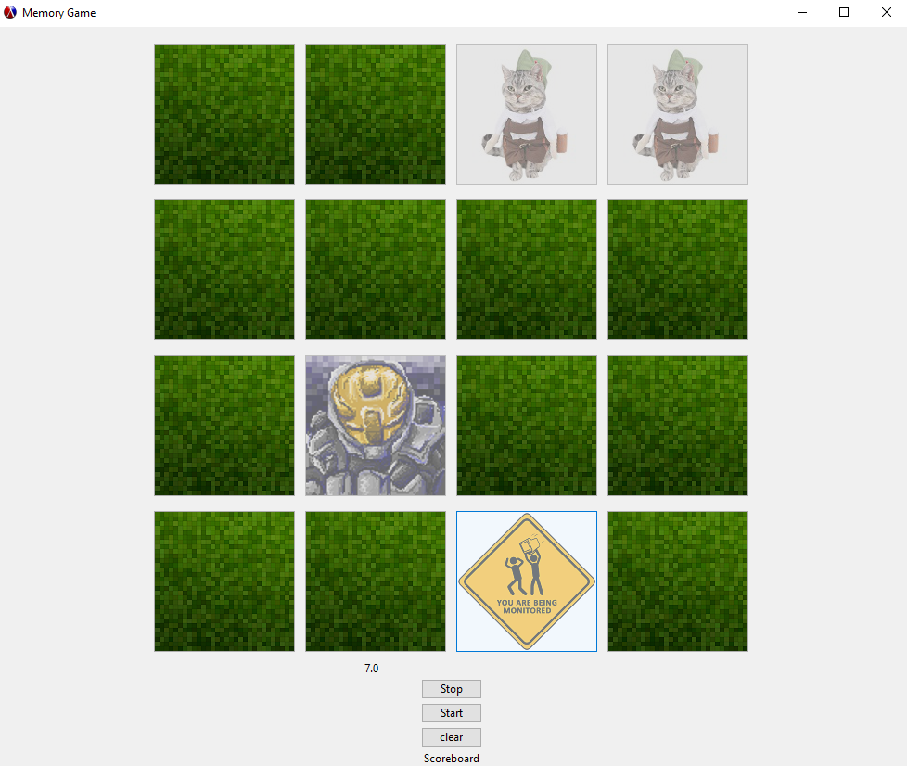
Initial design Idea
After we had the core of our memory game down we implemented a start clear and stop buttons for the users to start the timer when they want to play and stop it when they have completed the level also clear their time to have multiple attempts at the same level.
This however is not a very good design idea as we have found out from our questionnaire that the users didn’t feel like the start, stop and clear buttons didn’t serve much purpose and hinder the playing experience. So we will have to remove them and replace them with other functions.

Slide 8
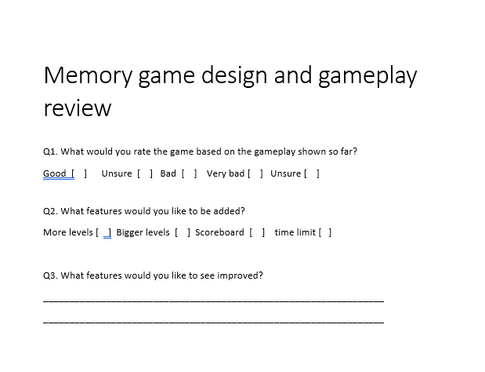
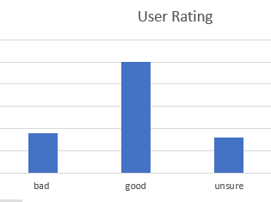
Questionnaire
We have designed this questionnaire because we feel like it is quite a good feedback for the game at this stage of implementation.
We have taken the users feedback and ensure that we implement the changes that they have requested for and make sure that the game meets expectations.
Judging on the results that we have so far most of the users have rated the game good and some have been unsure and a small portion voting bad.
However some of the feedback has been quite good and has give us something to work on to improve the game further for example most people wanted a scoreboard and to remove the extra star, stop and clear buttons which we will be working on.

Slide 9
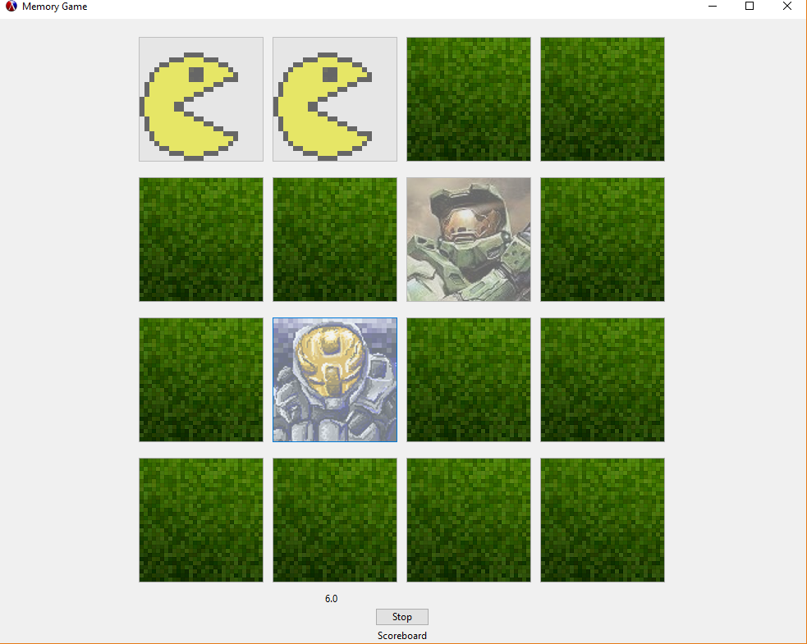
Improved design progress
We have worked on some of the user suggested changes and so far we have removed two of the buttons that were hindering the games overall gameplay.
As of now we are trying to improve the scoreboard system so that the user can see high scores and have people to compare against after each completion of any level.

Slide 10
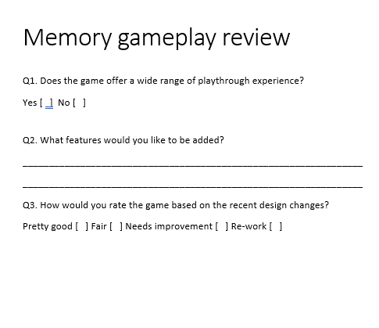
Questionnaire 2
This questionnaire has been focused more on the gameplay aspect of the game and how we could improve on the games overall playthrough experience and hopefully improve on features that may be lacking or implement some features that could be useful to the overall gameplay experience.

Slide 11
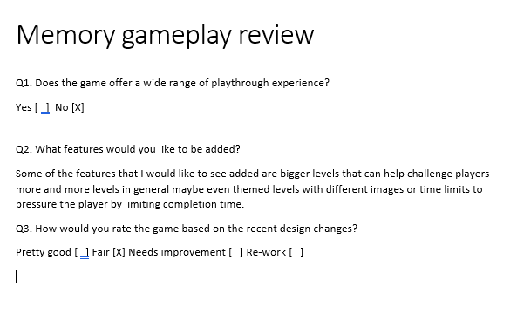
More improvements
Some of the improvements that users suggested that we need to implement is to have more levels and more grids to be added to the game to make it harder to complete. Implement a time limit so players are not allowed to take too long in completing the game and therefore increasing the overall gameplay experience.
We have yet to implement these changes but they will hopefully be coming soon.

Slide 12
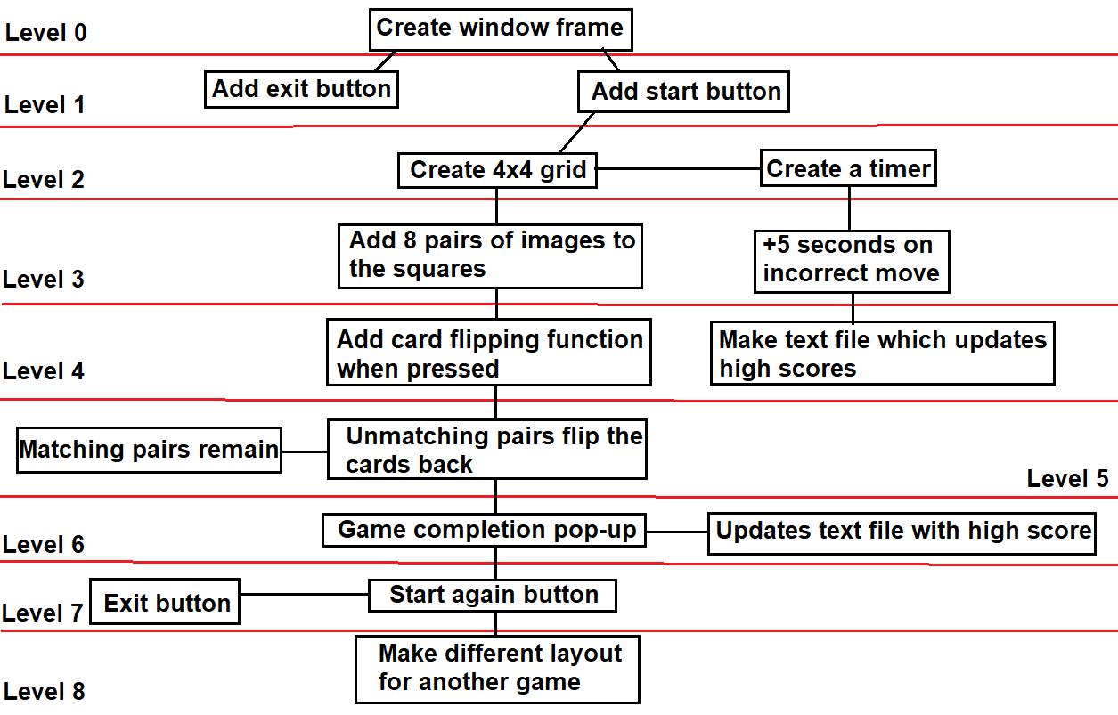
Top to down design

